Slide 1

Website Development: Lesson 20
Facilitated by: Titus Kariuki
Notes:
Web development kahoot

Slide 2
Agenda
We’re sad to see you go…😪
But now you have the skills to go off and make money!!!🤑🤑🤑
Resume
What makes an effective resume
How to describe your skills/relevant work experience to an employer
2. LinkedIn
What is it and why is it important
What makes a good LinkedIn profile

Slide 3

Resume…your time to gloat

Slide 4
Resume - what is needed
Contact information: Name, email, phone number and LinkedIn profile
Education
Skills (technical, research, etc.)
Part-time jobs held while in school and/or previous internships
Projects/Extracurricular activities/Volunteer work

Slide 5



Resume Must-Haves
Show measurable results whenever possible.
ROI
Visually appealing
Create a professional design that matches your brand.
Error-free
Double-check spelling and grammar.
Notes:
Focus on ROI.
Show the impact of your efforts.
Spell out measurable results whenever you can.
Your resume should look as good as it reads.
Make sure your resume is clean, readable and visually appealing.
If your resume has errors in it, then nothing else matters.
Just one typo can sink even the best candidate.
Have several friends and/or family members read it for typos and legibility.

Slide 6
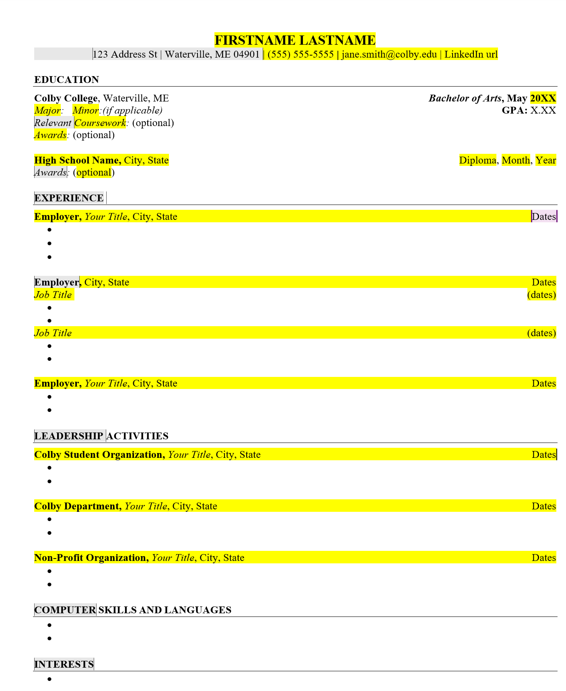
Resume - what is needed

Slide 7
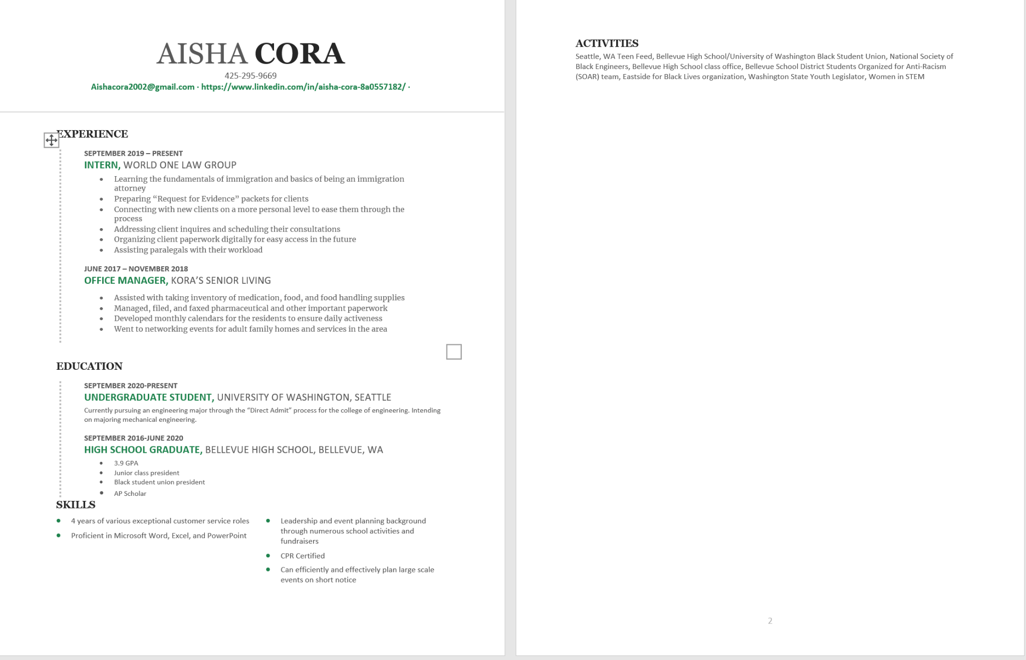
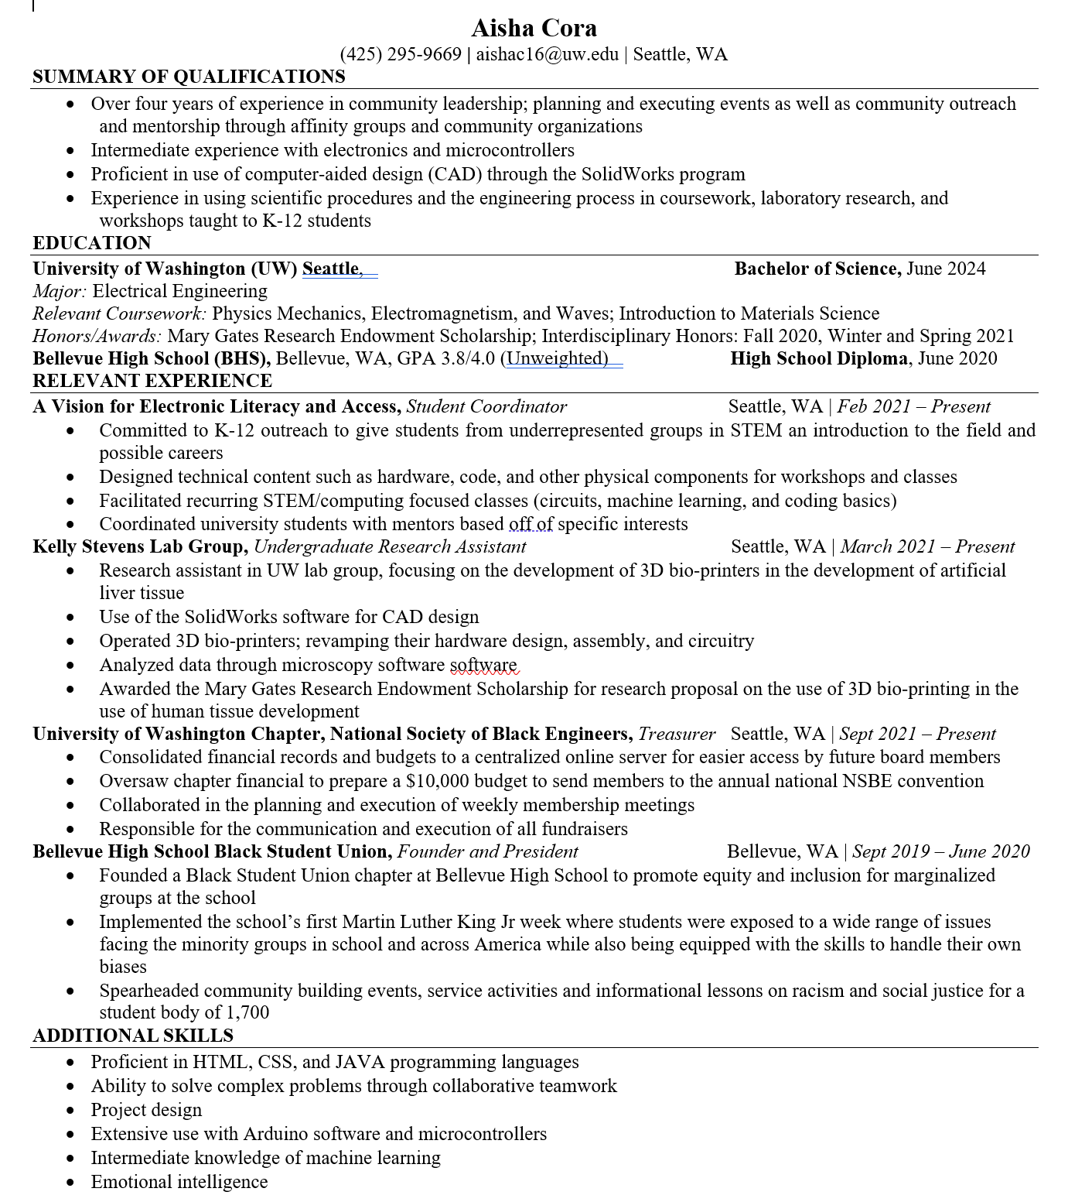
Resume -Examples
BAD
GOOD

Slide 8
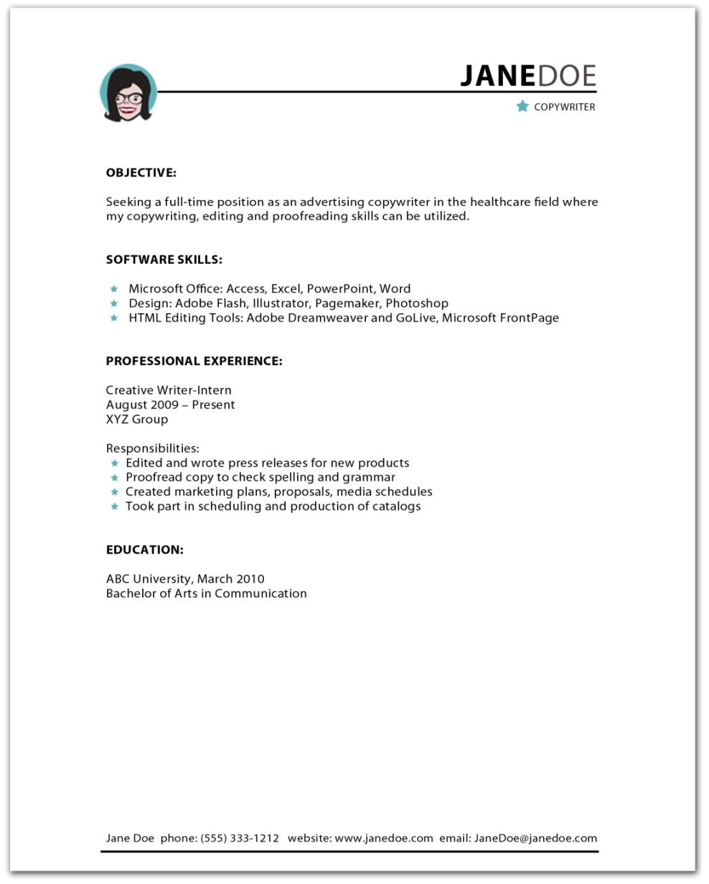


Honest
Easy to understand
Keyword-rich
Customized
Notes:
A resume is essential to your personal brand and job search.
In most cases, it’s your target’s intro to your brand.
According to a Robert Half survey, managers said they look at 40 resumes per job opening, on average, and spend 12 minutes on each resume. [SOURCE: http://rh-us.mediaroom.com/2018-03-20-Promising-Resumes-Often-Dont-Equal-Promising-Hires]
Make an immediate positive impression.
Sell yourself, but be honest — don’t embellish.
Many companies conduct background and reference checks.
Concentrate on the best way to showcase your true skills and qualifications.
List your best qualifications first, either internship or work experience or a high GPA and several academic awards.
Include keywords from the job posting if — they truly describe you.
Customize the main points for each job you apply for.

Slide 9
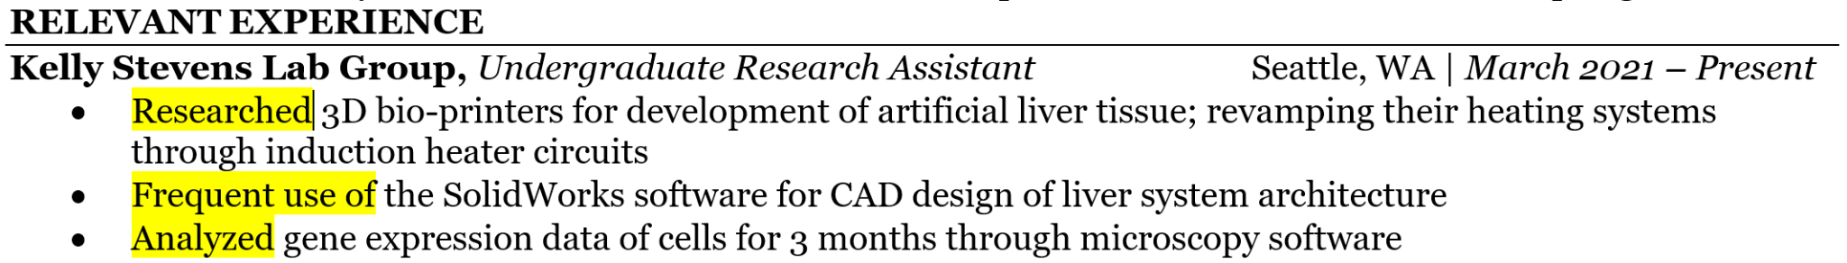
Resume - Examples

Slide 10

Successful LinkedIn Leads to a Successful Career

Slide 11
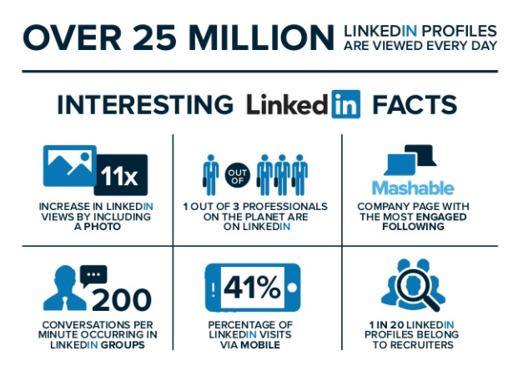
LinkedIn Profile
Build Network and Use Day-to-Day
Build Network
Manage your network
Find and add connections
LinkedIn Groups
Communicate with messaging
Use Day-to-Day
Explore the feed
Customize your feed
Share updates and content
Search for jobs
Open to job opportunities

Slide 12
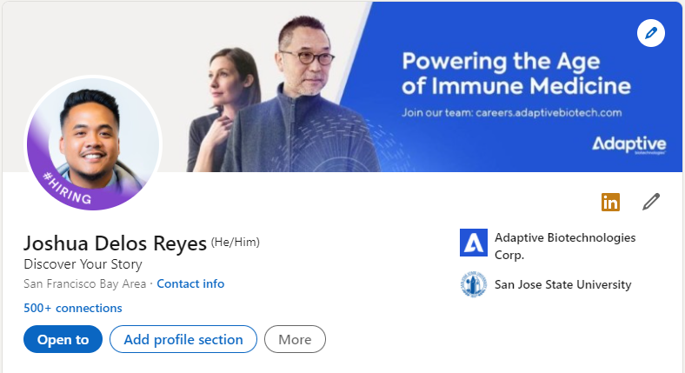
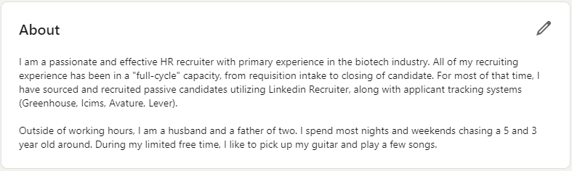
LinkedIn Profile - Creation
Set up a new LinkedIn account
Add a profile picture
Add a background image
Personalize your headline
Add a summary
Add Key words
Add work/research experience
Add education

Slide 13
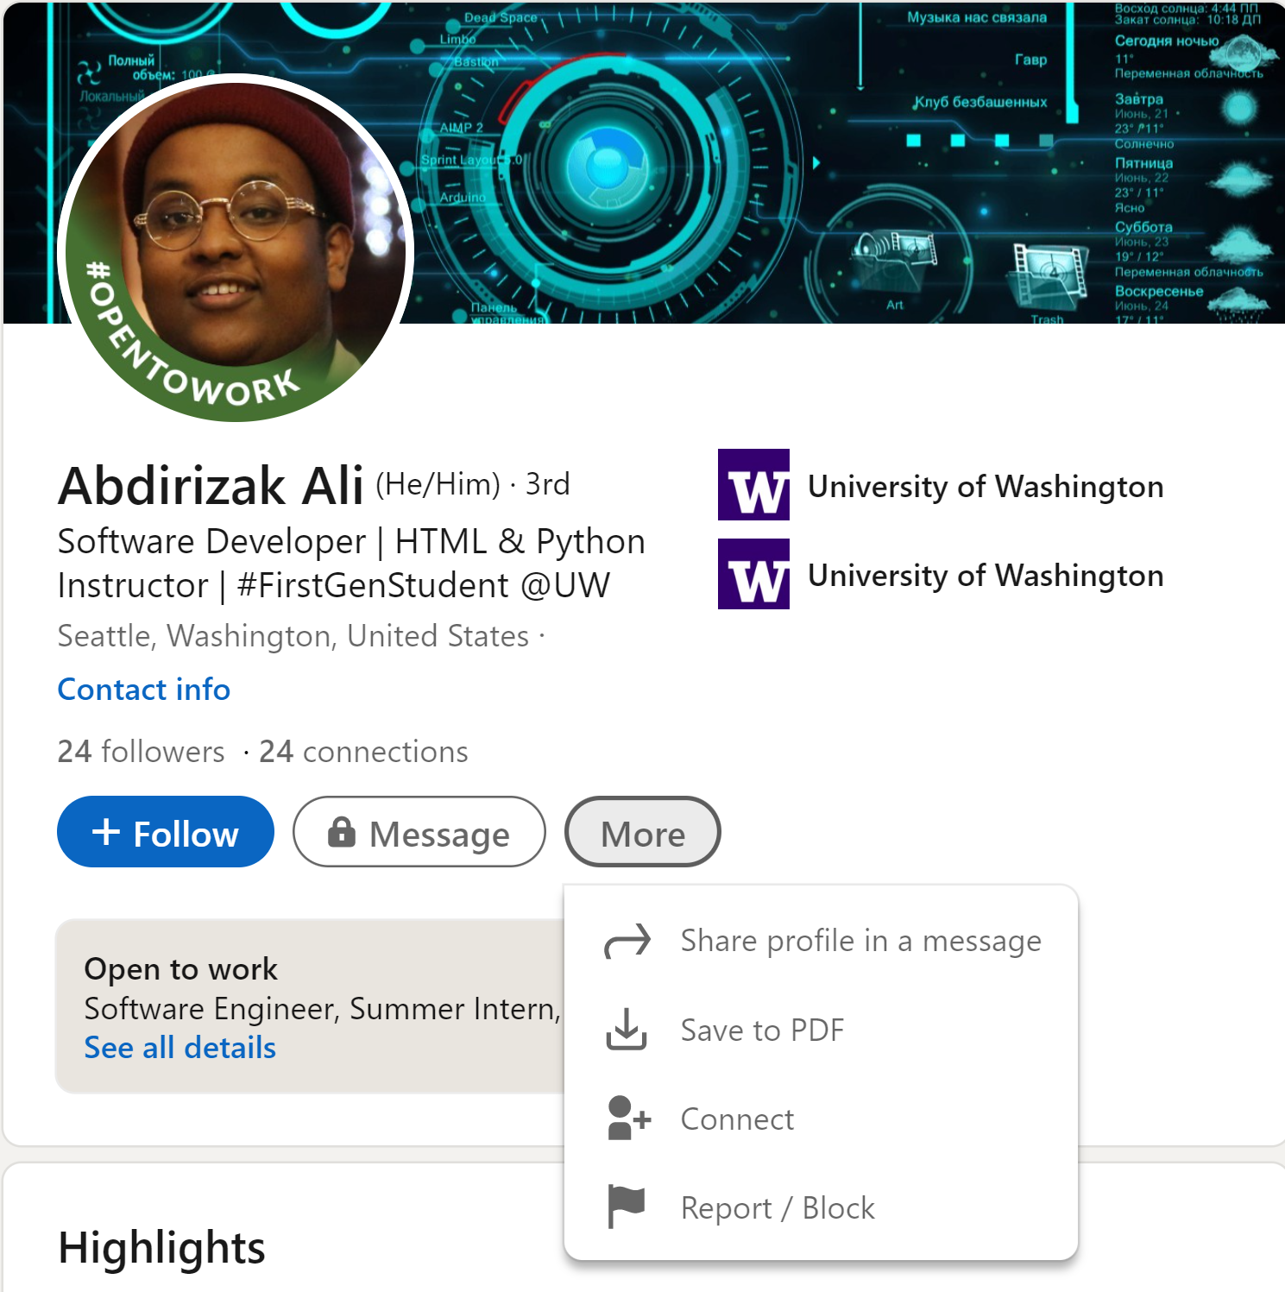
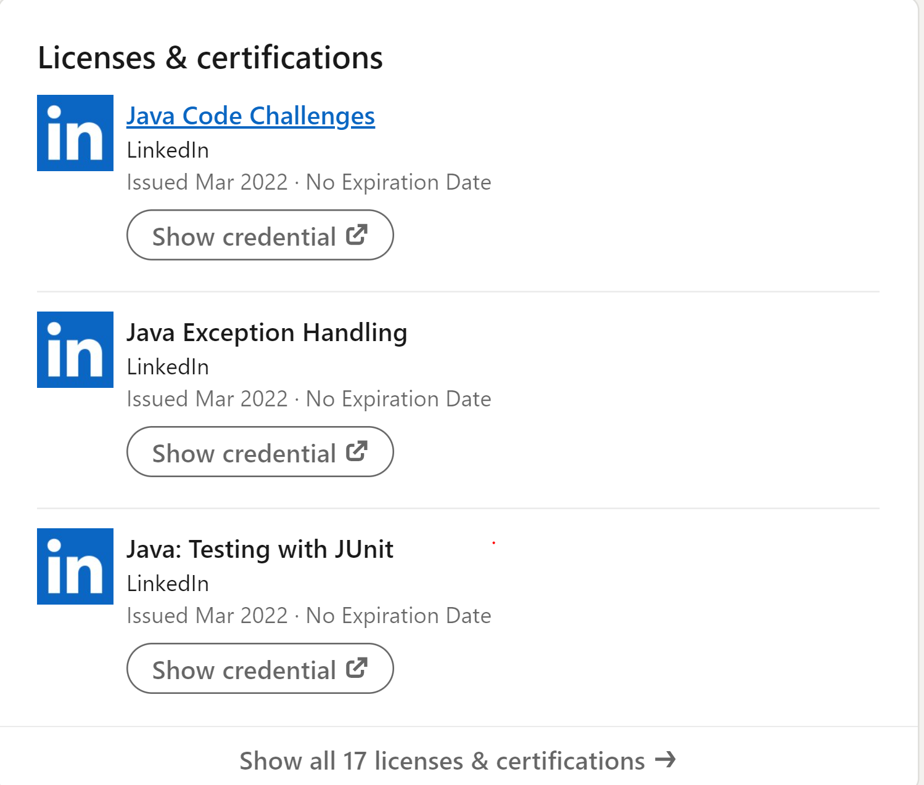
LinkedIn Examples

Slide 14
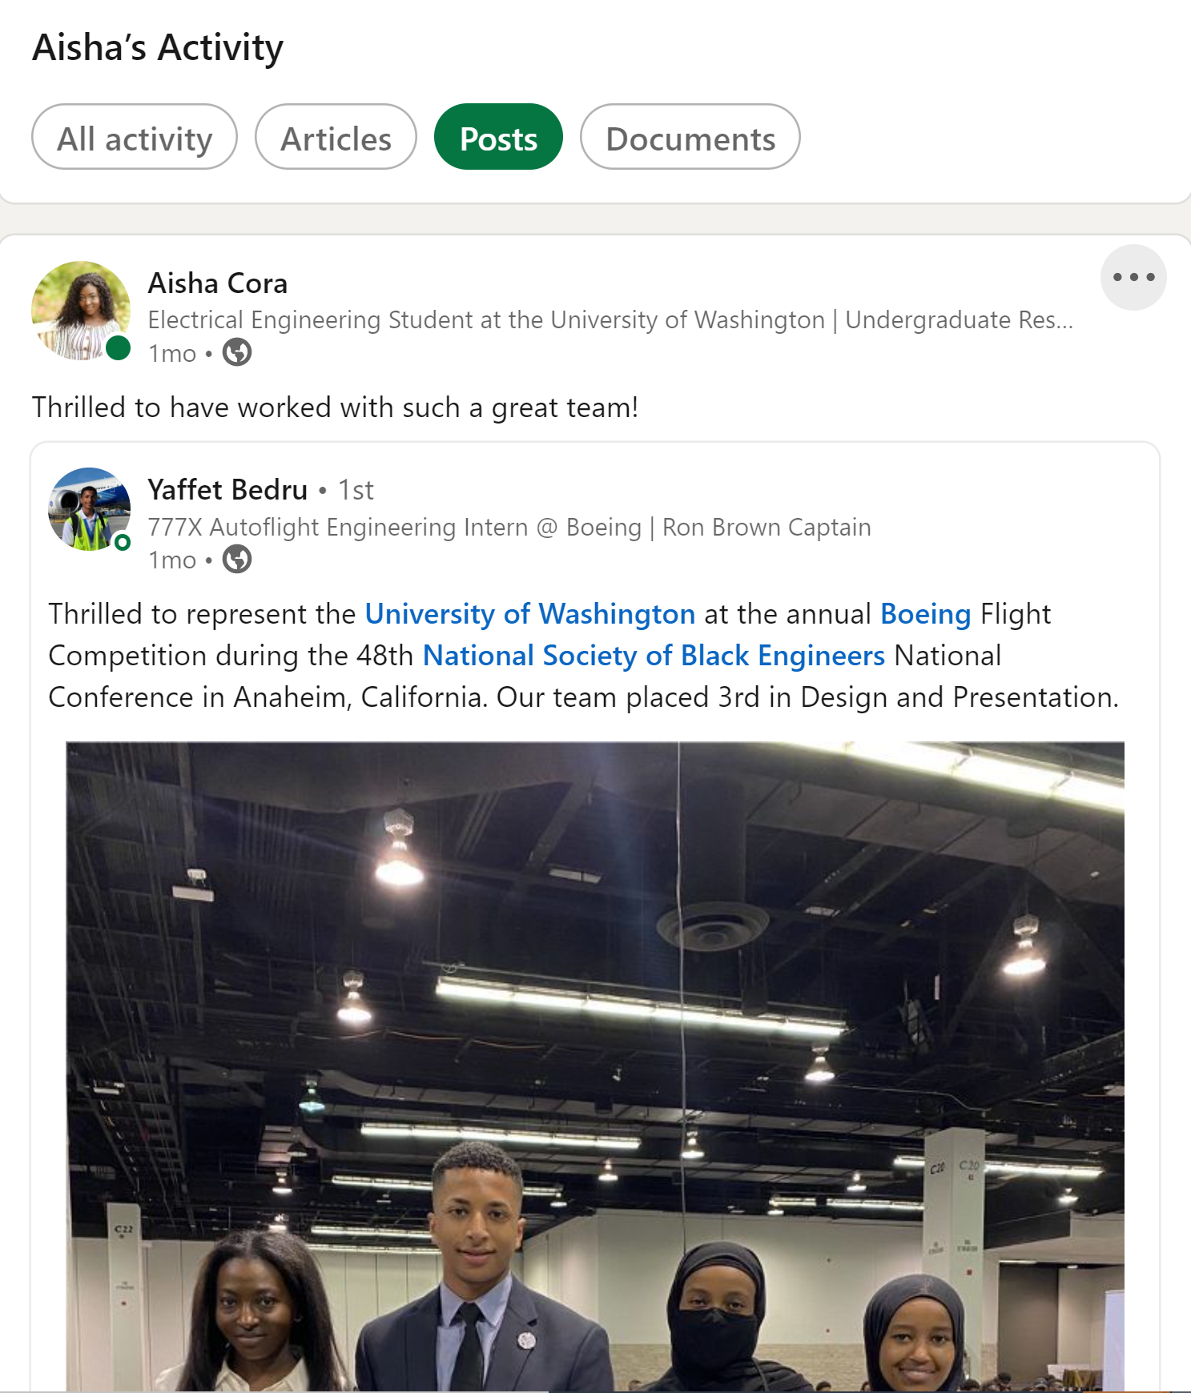
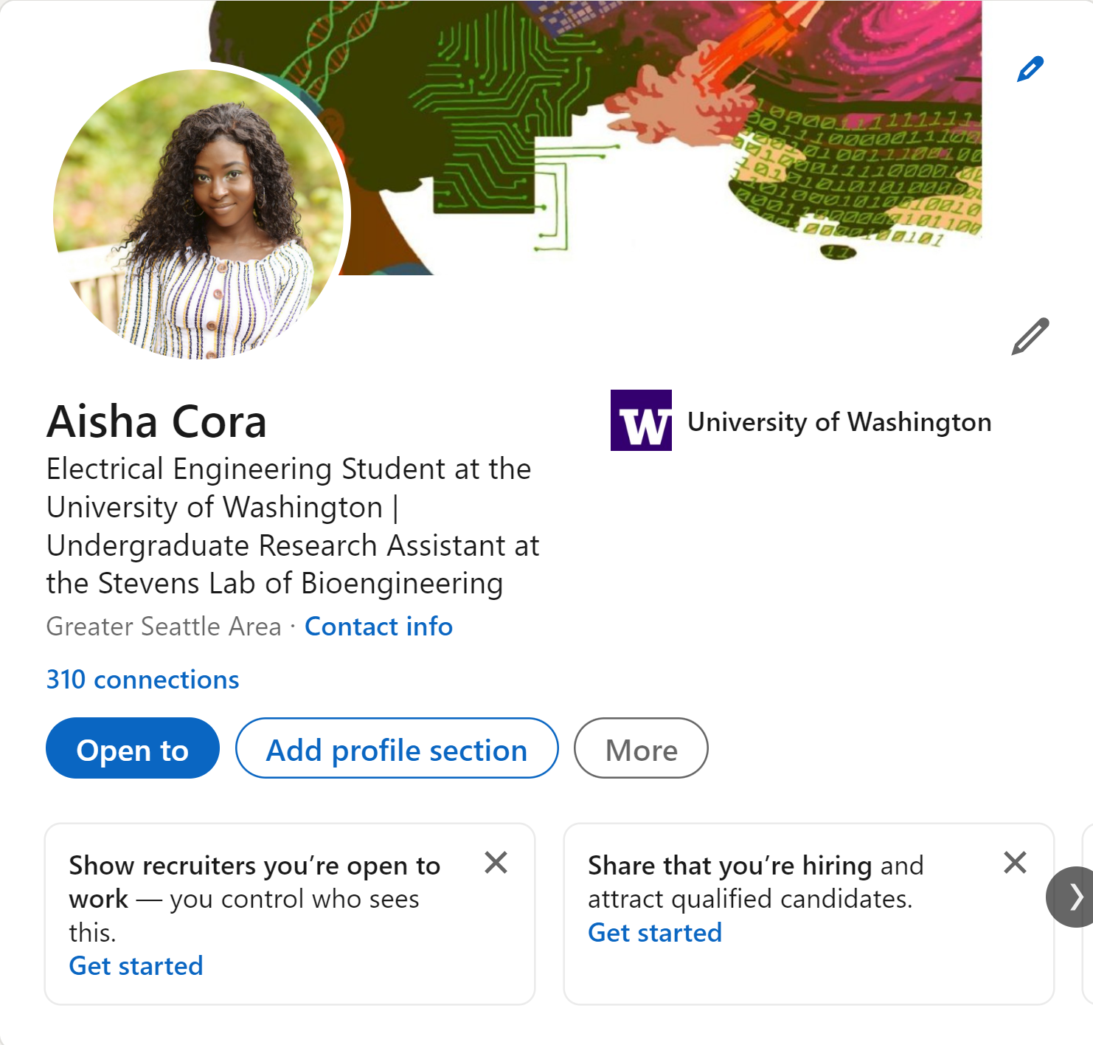
LinkedIn Examples

Slide 15

It’s all about building your professional brand
Who are you and what makes you unique in your field

